Slide 1
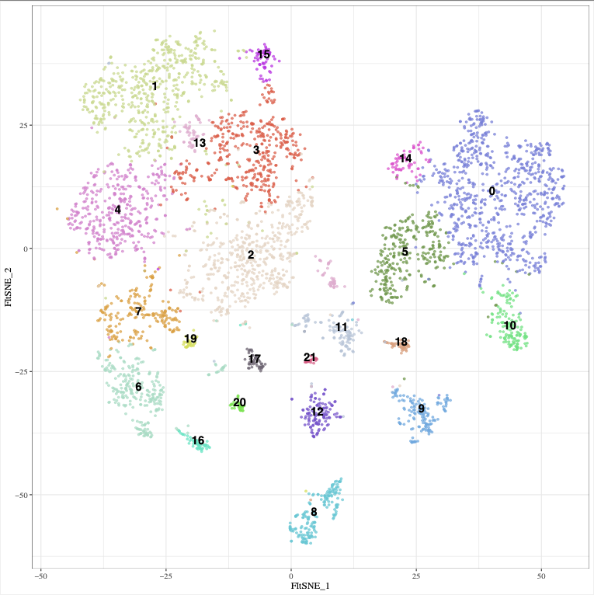
0: Capillary ECs
1: Folr2+ Monocytes
2: Lars2+ MΦ
3: Trem2+ MΦ
4: MHCII MΦ
5: Sprouting ECs
6: mDCs
7: Cd14+ MΦ
8: Fibroblasts
9: Mural Cells
10: Lymphatic ECs
11: Red Blood Cells
12: MuSCs
13: Erythrophagocytes
14: Large Vessel ECs
15: M2-like MΦ
16: Regulatory T Cells
17: NK Cells
18: Schwann Cells
19: NKT Cells
20: pDCs

Slide 2
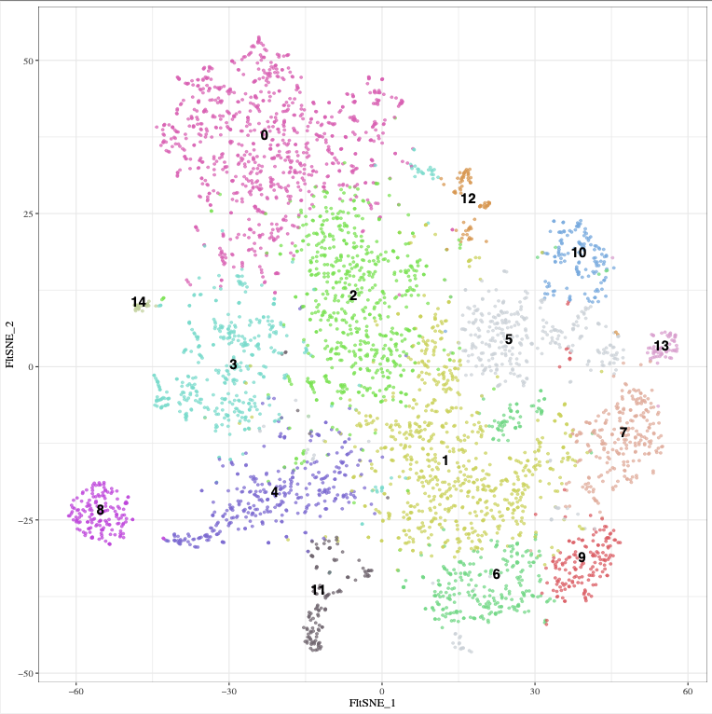
0: Fibroblasts
1: « Naive » MΦ
2: Sparc+ MΦ
3: MuSCs
4: Sprouting ECs
5: Lars2+ MΦ
6: Trem2+ MΦ
7: MHCII+ MΦ
8: Capillary ECs
9: Folr2+ Monocytes
10: Cd14+ MΦ
11: Mural Cells
12: Cytotoxic T cells
13: mDCs
14: Schwann Cells

